Slide 1
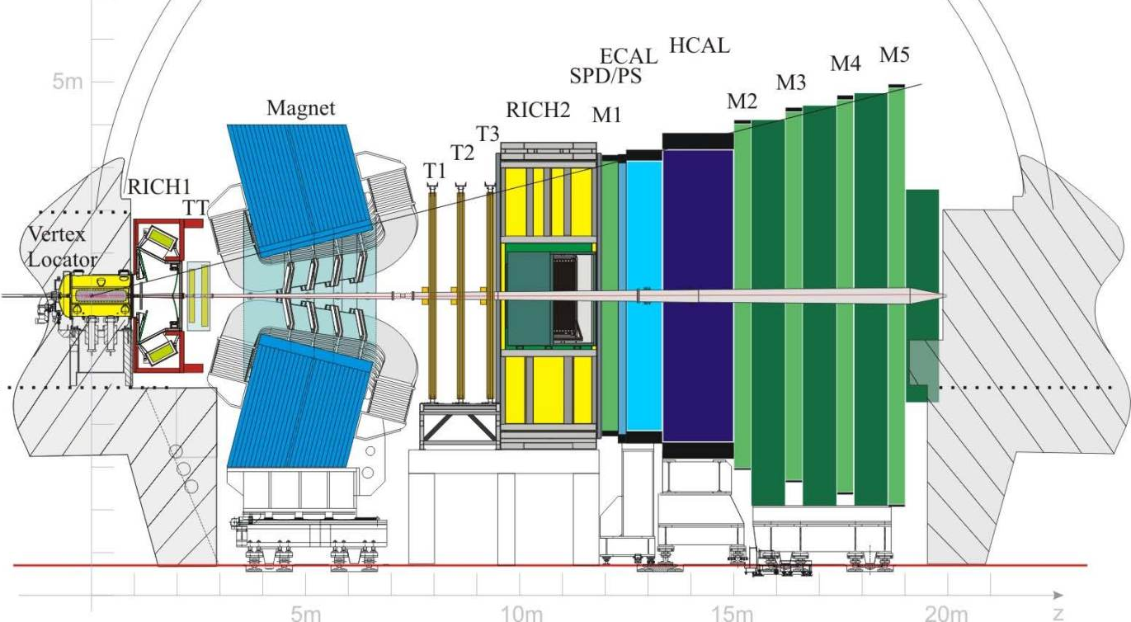
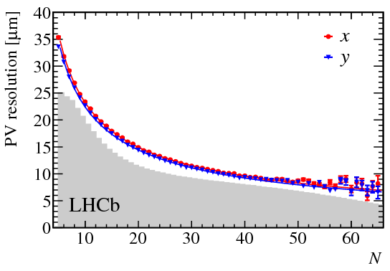
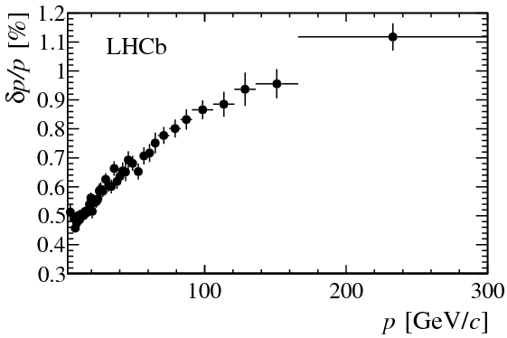
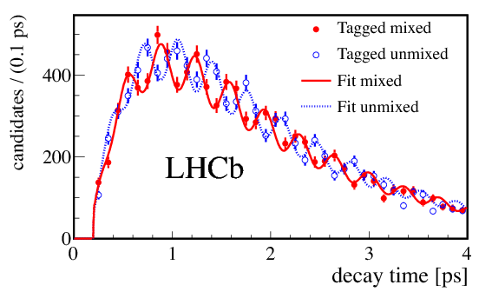
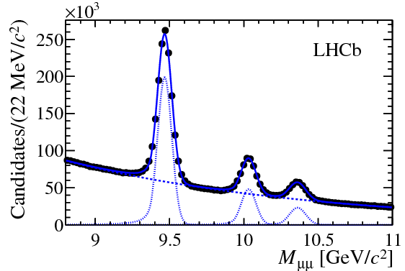
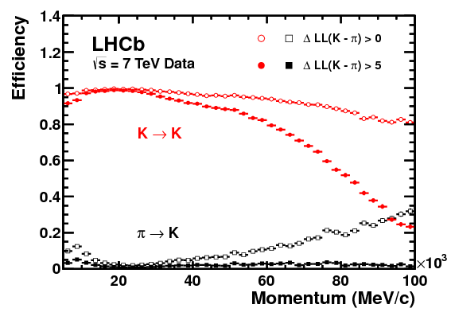
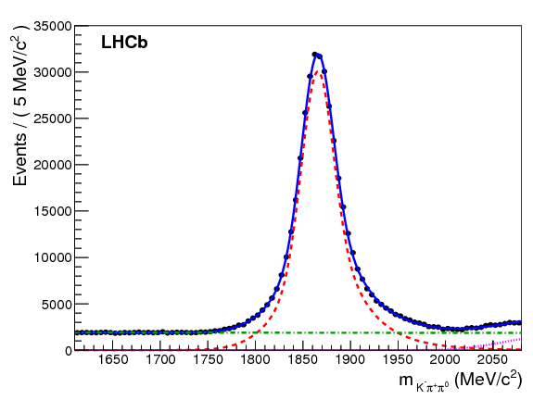
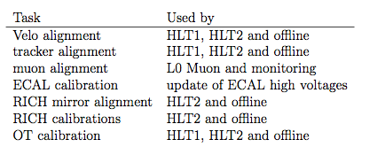
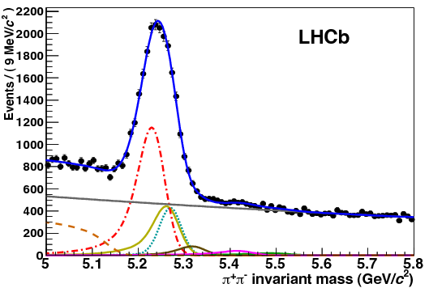
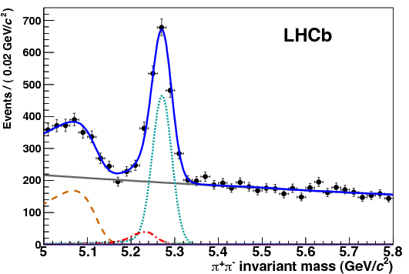
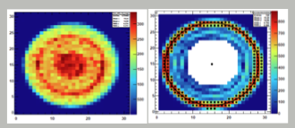
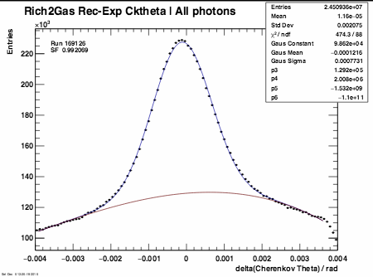
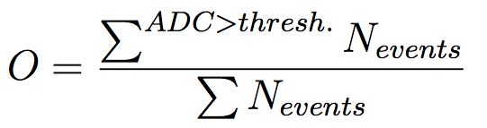
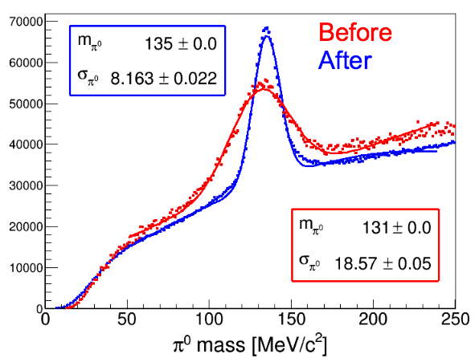
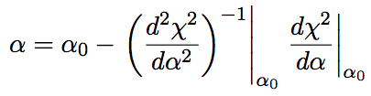
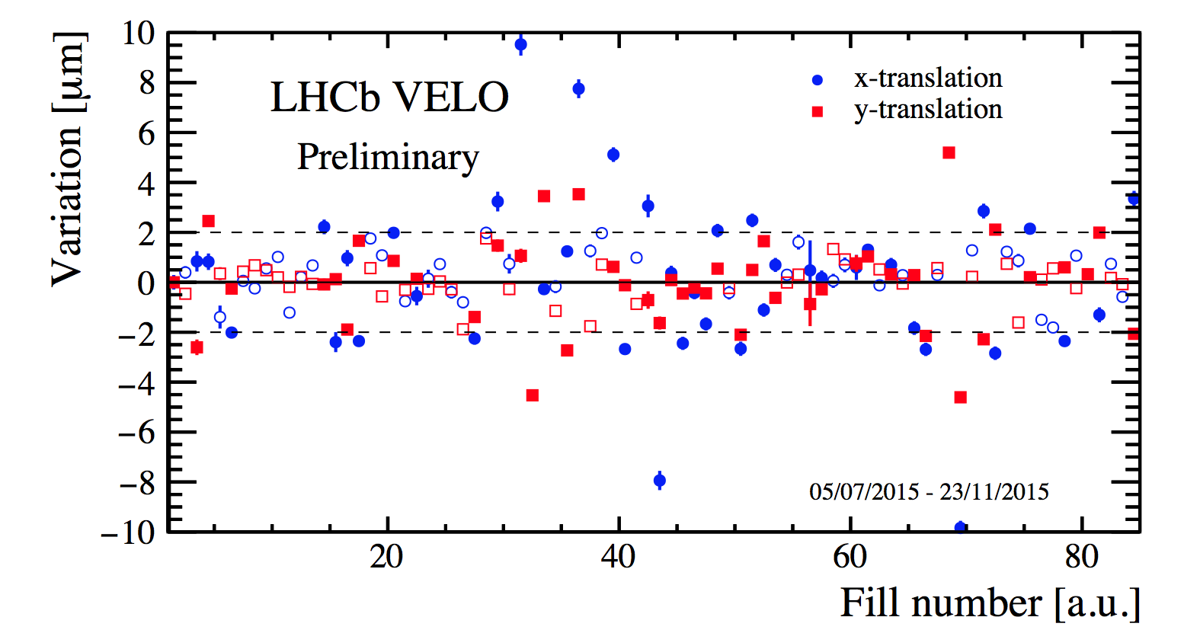
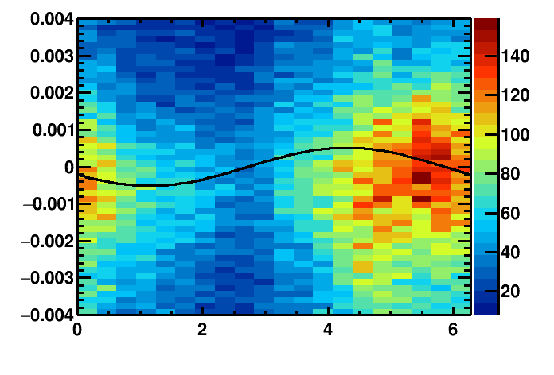
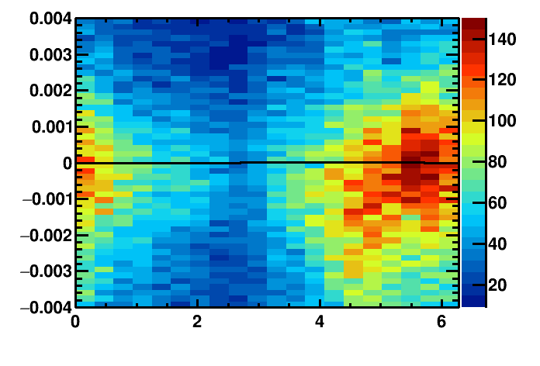
Novel real-time calibration and alignment procedure for LHCb Run II
Claire Prouve, on behalf of LHCb collaboration
New challenges in Run II
The LHCb Detector
xxx
Increase in energy: √s = 7(8) TeV ⇒ 13 TeV
15% increase of inelastic collision rate
20% increase of multiplicity per collision
60% increase of σ_{bb ̄} and σ_{cc ̄}
Reduced bunch spacing: 50 ns ⇒ 25 ns
2.4 · 10¹² B hadrons in LHCb detector acceptance in 2011 + 2012
Vertex resolution
Momentum resolution
Real Time Alignment and Calibration
xxx
Particle identification useable in HLT2
Overall improved HLT2 efficiency
Stable quality of alignment
No more differences between online and offline
Decay-time resolution
Mass resolution
PID efficiency
π⁰ reconstruction
LHCb Trigger Schemes
Performance and Impact on Physics
First alignment
Improved alignment
Alignment Farm and Framework
RICH Calibration
Alignments performed for each fill
HLT farm with 1700 nodes
HLT1 line for each task
Event reconstruction parallelised
1 iterator + 1700 analysers
Steered by the run control using a Finite State Machine
VELO, Tracker + Calibrations: automatic update of the constants if they differ by a given value
RICH alignment + Muon System: monitoring mode
xxx
HPD image calibration: Sobel fit performed for each HPD and used to provide calibration for each anode element.
Refractive index calibration: Fit to the reconstructed-expected Cherenkov angle yields (n-1) scale factor.
Updated every run.
Example of alignment sequence
Calorimeter Calibration
ccc
Occupancy calibration for each cell
Scale the High Voltage by factor α to keep the gain stable by evaluating the variation of the occupancy
Updated per fill
Calibrate to the neutral π mass
Fit the π⁰ mass distribution for each cell for π⁰ γγ, one γ has its seed in the cell and use the offset to the nominal π⁰ mass as calibration
Run on the HLT-farm during TS
Tracker Alignment: VELO, Tracker, Muon System
xxx
Position of the tracking elements in x and y
Minimisation of residual of Kalman track fit using additional constraints (e.g. magnetic field, particle masses)
Independent alignments:
VELO & Tracker: every O(1) fills
Tracker: every O(1) weeks
Muon system: XXX
RICH Mirror Alignment
Orientation of the RICH mirrors in x and y
Fit the variation of the Cherenkov angle Δθ as a function of the polar angle ϕ to extract the misalignments on the detector plane (Θ_{x}, Θ_{y}):
Δθ = Θ_{x} sinϕ+ Θ_{y} cosϕ
Monitoring mode, update O(10) times a year
Outer Tracker Calibration
xxx
Global time alignment for all modules
Fit the residual of the drift time to extract the global time delay t₀ caused by readout electronics
t_{meas} = t₀ + t_{flight} + t_{drift} + t_{prop}
Update triggered every O(10) runs
LHCC - 02 March 2016 - Poster Session

